Slide 1


Project REPORT

Slide 2
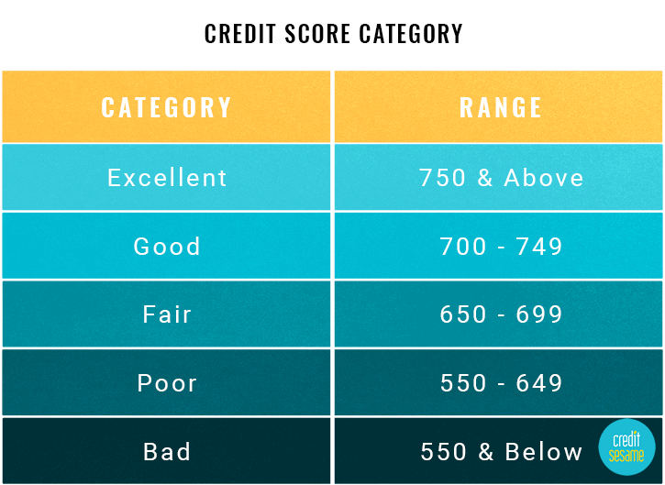
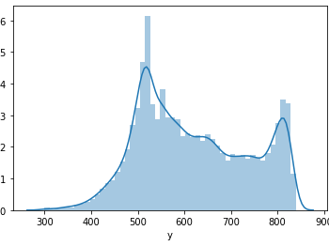

Target analysis – is it credit scoring?
The target distribution is shown in the bottom left chart.
It seems like a credit score
Credit score category cutoff and target distribution deflections are more correlated
The following target distribution transformation are considered in this project
No transformation
Quantile Transformation
Scaled transformation (Min Max & Standard)

Slide 3

Assumptions
The target column could be a credit score. So, the minimum value should be 300 and the maximum value should be 850.
Variables with 70% or more missing values are not useful for prediction
First column ‘x001’ is a unique identifier column – The reason is because the length of the table matches the unique values
Variables with cardinality of 1 are not useful for prediction

Slide 4
Methodology I - Pyspark
1. Variable Transformation
2. Variable Selection
3. Target transformation
4. Build machine learning model
5. Evaluate model
Consider target as continuous
Perform variable selection based on voting-based approach which is a ensemble variable selection
Pick the best features
Build Random Forest model, Decision Tree model
Evaluate RMSE, Accuracy & R squared
Repeat steps 1-5 with different target transformations as shown before – quantile, minmax, scalar
Final selected variable using Pyspark approach – 30 variables

Slide 5
Methodology II - PYTHON
1. Variable Transformation
2. Variable Selection
3. Target transformation
4. Build machine learning model
5. Evaluate model
Get the subset variables from Methodology I (30).
Perform variable transformation based on input variables based on
Quantile transformation
Minmax
Power transformation
Outlier based transformation (capping outliers)
Build tree based & Deep Neural network models.
Evaluate RMSE, Accuracy & R squared
Repeat steps 1-5 with different target transformations as shown before – quantile, minmax, scalar & for different hyperparameters optimized with hyperopt.

Slide 6
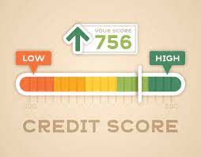
Methodology III – CREDIT SCORING
Binary target – Above 600 and Below 600
Calculate WOE and IV for input variable based on binary target
Score_i= (βi × WoE_i + α/n) × Factor + Offset/n
∑Score_i as credit score
I used my own python package Xverse for WOE & IV calculation and calculated the credit score.
In addition, tried scorecardpy python package
Interesting approach, laid out methodologies for two step model – classification followed by continuous.
I extended the approach to classify the FICO credit score categories – Bad, Poor, Fair, Good and Excellent

Slide 7

Methodology IV – Optimizations
Hyperparameter optimization using Hyperopt
PCA based components for variable reduction and creating composite columns
Variational auto encoders for variable reduction and introducing a randomness in the the generated output
Two stage model – Classification + Continuous

Slide 8

Algorithms Tried
Tree based – Decision Tree, Random Forest, Gradient Boosting & XGBoost
Neural Networks – MLP, DNN, VAE
PCA
Hyperopt – Parameter optimization
Support Vector Machines
Linear – Ridge, Lasso, ElasticNet
LightGBM

Slide 9

Tools & Framework
PySpark
Python
Docker
Flask – Rest API
Tensorflow
Scikit-learn
Keras
Colab

Slide 10

Model evaluation
Final selected model – XGBoost Regressor with parameters shown to the left
RMSE – Root mean square error
Train - 26.76, Test - 28.87
Accuracy – Absolute difference of 3 between predicted and actual
Train - 0.13, Test - 0.12
R squared – Model fit
Train - 0.95, Test - 0.94
reg = xgb.XGBRegressor(learning_rate=0.01,
n_estimators=6000,
max_depth=4,
min_child_weight=0,
gamma=0.6,
subsample=0.7,
colsample_bytree=0.7,
nthread=-1,
scale_pos_weight=1,
seed=27,
reg_alpha=0.00006,
random_state=42)

Slide 11

How to run the model?
Unzip the .7z file to get the csv file. Note: Once you have the csv ready, you can execute the below steps.
Unzip the solutions file and using the command prompt navigate to the directory
docker build -t scoring_image .
docker run -p 5000:5000 scoring_image:latest
Now you should see the flask app running. In a new terminal, navigate to the same directory and execute the command below.
python run.py score_file.csv
This will produce an output file score_output.csv in the same directory which has the prediction results
To run-in real-time mode, use POSTMAN or other API services.

Slide 12

Follow up
The model is performing better in terms of RMSE and R squared. The accuracy value is not that great; however it is better when compared to the rest of the models, I have tried before
Tweaking each model and combining credit scoring approach to regression model techniques could yield better results

Slide 13



